Slide 1
Slides for Karl Berator
William Pincombe

Slide 2
Gene Expression data for cell line Wild Type (WT)
Concentration | Gene Expression – placebo |  | Gene Expression – AF42
 | Trial 1 | Trial 2 | Trial 1 | Trial 2
0 | 5.51 | 4.47 | 9.10 | 9.69
1 | 6.41 | 5.12 | 11.88 | 12.82
2 | 5.71 | 4.79 | 15.21 | 14.78
3 | 7.94 | 5.86 | 18.41 | 18.27
4 | 6.87 | 4.30 | 23.81 | 21.24
5 | 7.29 | 5.82 | 25.10 | NA
6 | 10.04 | 9.94 | 28.75 | 24.25
7 | 8.85 | 9.02 | 30.99 | 29.11
8 | 8.91 | 8.23 | 36.33 | 32.79
9 | 9.68 | 8.37 | 36.00 | 32.69
10 | 11.43 | 10.47 | 41.70 | 36.38

Slide 3
Gene Expression data for cell line CT101
Concentration | Gene Expression – placebo |  | Gene Expression – AF42
 | Trial 1 | Trial 2 | Trial 1 | Trial 2
0 | 5.35 | 5.81 | 8.97 | 11.49
1 | 4.01 | 6.58 | 11.62 | 15.01
2 | 8.53 | 9.28 | 14.87 | 17.88
3 | 9.90 | 10.71 | 15.47 | 20.17
4 | 11.66 | 13.67 | 17.29 | 26.22
5 | 10.70 | 13.48 | 20.78 | 31.77
6 | 13.65 | 15.20 | 22.30 | 34.43
7 | 15.98 | 17.65 | 24.37 | 36.66
8 | 16.74 | 19.01 | 27.44 | 39.26
9 | 18.44 | 19.93 | 30.74 | 44.18
10 | 20.21 | 24.47 | 33.96 | 48.96

Slide 4
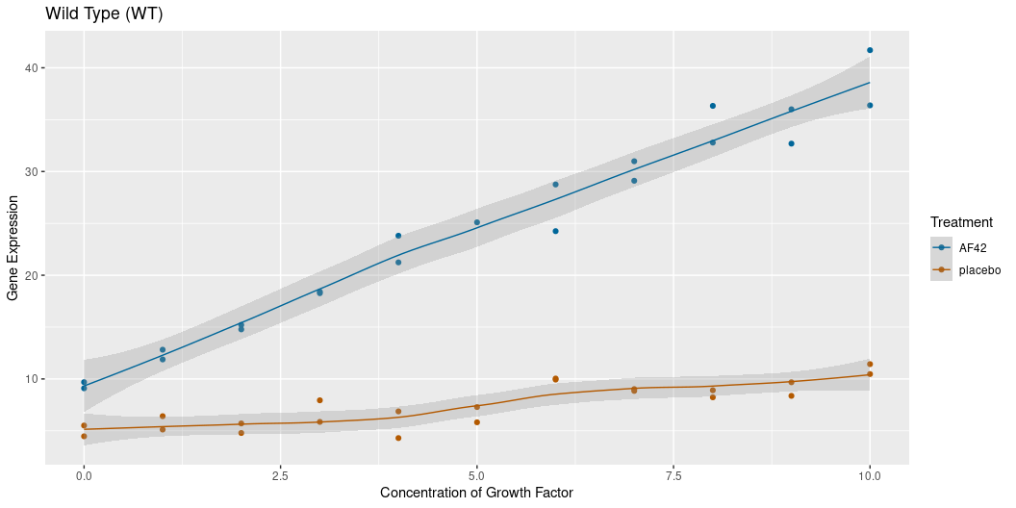
Scatterplot for Wild Type

Slide 5
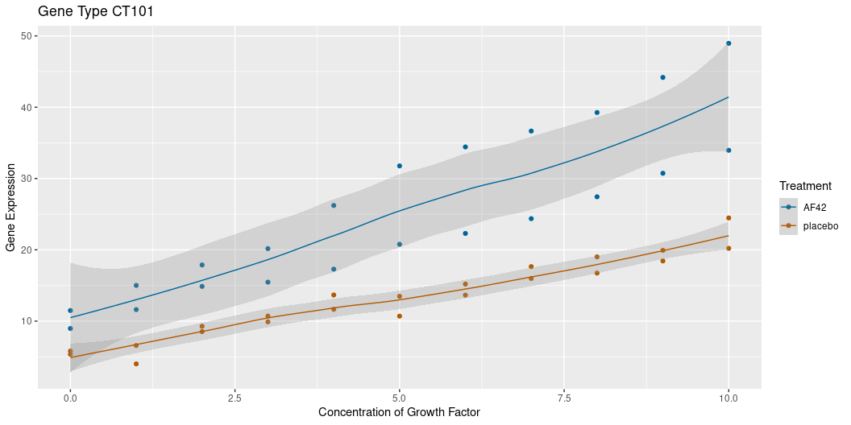
Scatterplot for CT101

Slide 6
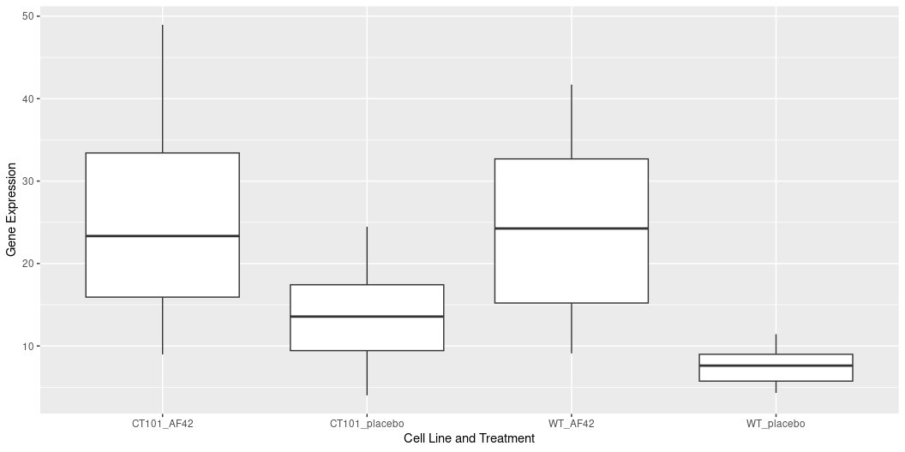
Side-By-Side Boxplots
These plots show the range of values of gene expression for each treatment and cell line. For each group, 50% of the data lies in the range given by the box, while the lowest and highest 25% are in the range given by the lines.

